Slide 1
Data structure and algorithm
Group members:
Sahar Fatima 002
Usman Shabbir 016

Slide 2
Girvan-Newman Community Detection Algorithms

Slide 3
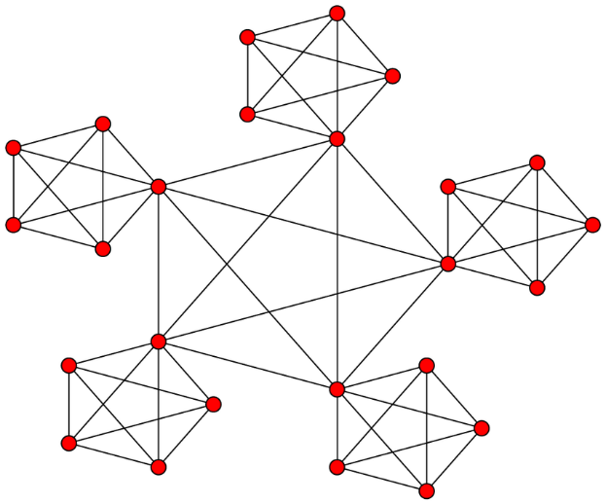
What is community?
“A community, with respect to graphs, can be defined as a subset of nodes that are directly connected to each other and loosely connected to the nodes in the other communities in the same graphs.”

Slide 4
Need of community detection:
We need community detection to discover people with common interest and keep them connected.
We need community detection in machine learning to detect groups with similar properties and extract groups for various purpose.
We need community detection in stock market.
Problem statement:
Over large scale, it is very difficult to configure the different communities, so we need the algorithms to partition the network in different communities.

Slide 5
Girvan-Newman Community Detection Algorithms
It is the technique for the detection and analysis of community structure depends upon the iterative elimination of edges with the highest number of the shortest paths that pass through them.
It follows the divisive hierarchical clustering based on edge betweenness.
Divisive hierarchical clustering:
Start with the complete graph and take off the edges iteratively. Edge with the highest weight is removed first and repeated.

Slide 6
Explanation:
This algorithm removes the edges of graph based on edge between centrality values.
Edge between centrality values:
It is the number of shortest paths that passes through the edge in a network. Each edge is given an EBC score based on the shortest paths among all the nodes in graph.
Shortest path:
Shortest path means the least distance amount between two nodes.

Slide 7
Steps:
Repeat until no edges are left.
Calculate EBC for every edge in graph.
Remove the edge with highest EBC.
Calculate EBC for remaining edges.
Connected components are communities.

Slide 8
Applications:
We need community detection to discover people with common interest and keep them connected.
We need community detection in machine learning to detect groups with similar properties and extract groups for various purpose.
We need community detection in stock market.

Slide 9
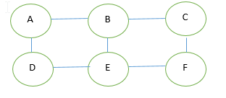
Example:
Take one node let say A . Directly connected nodes are B and D.
Shortest path of AB and AD.

Slide 10
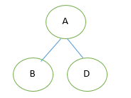
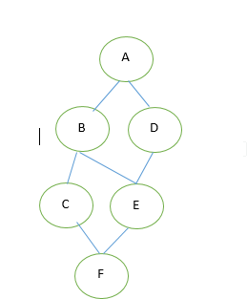
Shortest path from A to C and E goes through D and B.
Shortest path to last node F goes through nodes B,D,C and E.
Edges are arranged according to the shortest path now we will add scores to them.

Slide 11
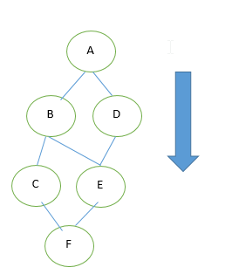
Adding Scores:
B=1,D=1
Because there is one shortest path to A.
C=1
Because there is only one shortest path from C to A.
E=2
There are 2 shortest paths from E to A, ABE, ADE.
F=3
There are 3 shortest path from F to A , ABCF, ABEF, ADEF.

Slide 12
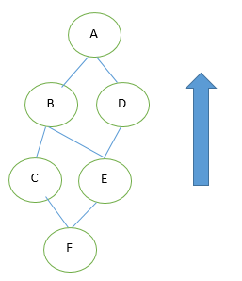
Computing scores foe edges:
FC=1/3=0.33
FE=2/3=0.667
CB=1+0.33(FC) =1.33
EB= (1+0.667(FE))/2=0.835
ED= (1+0.667 (FE))/2=0.835
BA= (1+1.33+0.835 (EB))/1=3.165
DA= (1+0.835 (ED))/1=1.835

Slide 13
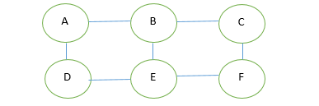
Repeat these steps for each node:
Edges | Edge betweenness
AB | 3.165+1.5+1.33+0.835+0.5+0.667 =8
AD | 1.835+0.5+0.33+1.835+0.5+0.33 =5.33
BC | 3.165+1.5+1.33+0.835+0.5+0.667 =8
BE | 0.835+2+0.835+0.835+2+0.835 =7.34
CF | 1.835+0.5+0.33+1.835+0.5+0.33 =5.35
DE | 3.165+1.5+1.33+0.835+0.5+0.667 =8
EF | 3.165+1.5+1.33+0.835+0.5+0.667 =8

Slide 14
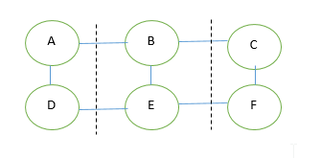
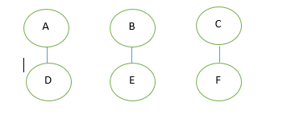
Divide scores by 2 and get the EBC
AB=8/2=4
AD=5.33/2=2.67
BC=8/2=4
BE=7.34/2=3.67
CF=5.35/2=2.67
DE=8/2=4
EF=8/2=4
According to algorithm after computing EBC remove the highest score edges. As we can see AB,DE,BC and EF have highest score.so we will strike them out and it will give us three sub graphs.
These 3 are subgraphs called communities.

Slide 15
Pseudo code:
Repeat
Let n be number of edges in graph
For i=0 to n-1
Let b[i] be betweenness centrality of edge i
If b[i] > max-b then
Max-b=b[i]
Max-b-edge =i
}}
Remove edge I from graph
Until number of edges in graph is 0

Slide 16
Advantages:
It helps in finding the community from graph.
It is suitable in small input of data.
Disadvantages:
This algorithm is not efficient in time with networks containing large number of nodes and data.

Slide 17
Complexity Analysis:
It has the time complexity, increasing up to O (n^3) or O (m^2n) on a scattered graph having m edges and n nodes.
As a result, Girvan-Newman is generally not used on large-scale networks. Its maximum node count is a few thousands nodes or less.

